Slide 1
Aligning Data Science Workloads with Document Databases

Slide 2
Introduction
More organizations implement big data technologies
Many of these technologies fail to improve the performance of existing tasks
Due to misalignments between existing tasks and big data technologies
This phenomenon can be explained using "task-technology fit"
Performance gains can be realized only if the capabilities of a technology match the requirements of a task performed using this technology

Slide 3
Goal
Examine the alignment between a data science task and a big data storage technology
Task: making movie recommendations using a collaborative filtering-based recommender system
Technology: a document database

Slide 4
Learning Objectives
At the end of this tutorial, you will be able to:
contrast a relational database with a document database
explain the collaborative filtering-based recommender system, which is one of the most popular recommender systems many online services use
contrast three types of designs one can implement in a document database
examine the performance implications of different levels of task-technology fit

Slide 5
Recommender Systems
Two types of recommender systems:
Content-based
Collaborative filtering-based
Collaborative filtering-based systems recommend items based on similarities with other users
"users who like this item also like that item"

Slide 6
Recommender Systems
Collaborative filtering-based systems require a "utility matrix"
Rows are "users"
Columns are "items" (e.g., movies)
Example utility matrix
"Ratings" are the values captured in the matrix
 | Movie 1 | Movie 2 | Movie 3 | Movie 4 | Movie 5
User 1 | 5 | 1 |  |  | 4
User 2 |  | 3 | 2 | 2
User 3 | 1 |  | 5 | 1
User 4 | 5 | 1 | 5 |  | 5

Slide 7
Recommender Systems
Utility matrix allows us to find users that are "similar" each other
 | Movie 1 | Movie 2 | Movie 3 | Movie 4 | Movie 5
User 1 | 5 | 1 |  |  | 4
User 2 |  | 3 | 2 | 2
User 3 | 1 |  | 5 | 1
User 4 | 5 | 1 | 5 |  | 5
User 1 and User 4 are very similar based on their ratings of movies. Then, we can recommend Movie 3 to User 1.
How can we find similar users more systematically?

Slide 8
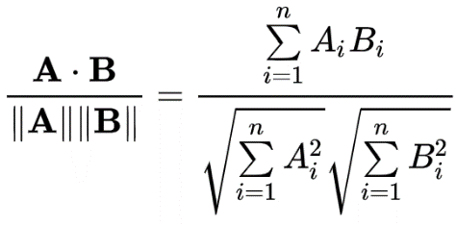
Recommender Systems
We can calculate "pairwise" cosine similarities
If A is one user and B is another user, their similarity is:

Slide 9
Recommender Systems
Example calculation of cosine similarities
 | Movie 1 | Movie 2 | Movie 3 | Movie 4 | Movie 5
User 1 | 5 | 1 |  |  | 4
User 2 |  | 3 | 2 | 2
User 3 | 1 |  | 5 | 1
User 4 | 5 | 1 | 5 |  | 5
Cosine similarity between User 1—User 4 = | $$\frac{\left(5x5\right)+\left(1x1\right)+\left(0x5\right)+\left(0x0\right)+\left(4x5\right)}{\left(\sqrt{5^{2}+1^{2}+0^{2}+0^{2}+4^{2}} \right) x (\sqrt{5^{2}+1^{2}+5^{2}+0^{2}+5^{2})}}=0.814$$
Cosine similarity between User 1—User 2 = | $$\frac{\left(5x0\right)+\left(1x3\right)+\left(0x2\right)+\left(0x2\right)+\left(4x0\right)}{(\sqrt{5^{2}+1^{2}+0^{2}+0^{2}+4^{2}) x} (\sqrt{0^{2}+3^{2}+2^{2}+2^{2}+0^{2}})}=0.112$$

Slide 10
Recommender Systems
Calculation of all pairwise similarities generates a "cosine similarity matrix"
This is a symmetric matrix with a diagonal of all 1's
(A user's similarity to themselves is always 1)
 | User 1 | User 2 | User 3 | User 4
User 1 | 1 | 0.112 | … | 0.814
User 2 | 0.112 | 1 | … | …
User 3 | … | … | 1 | …
User 4 | 0.814 | … | … | 1
Cosine similarity matrix

Slide 11
Document Databases
Store large volumes of data using distributed computing
Data is stored in schema-less databases
Collections: corresponds to "tables" of relational databases
Documents: corresponds to "rows" of relational databases

Slide 12
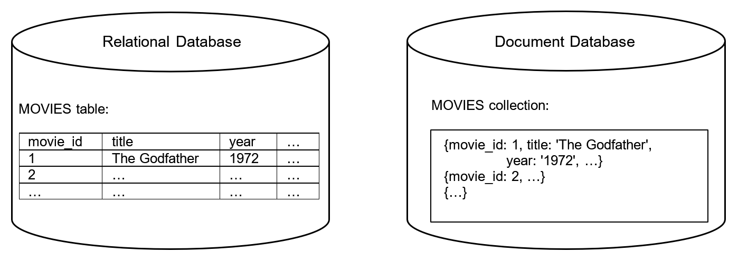
Document Databases
Data is stored using key-value pairs

Slide 13
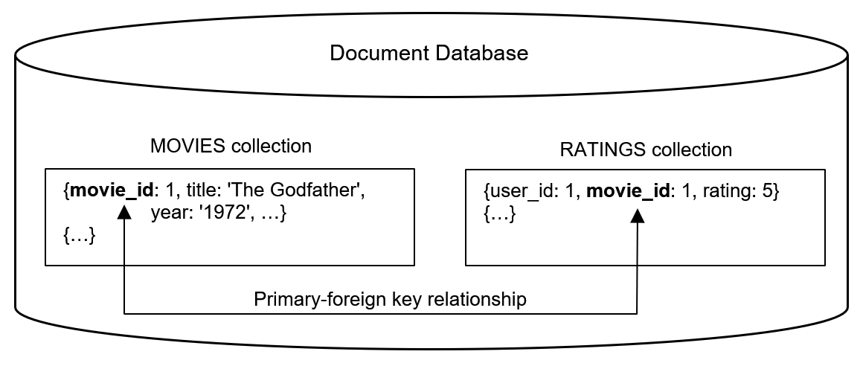
Document Databases
If there is more than one collection, relationships can be established using pseudo primary-foreign key relationships

Slide 14
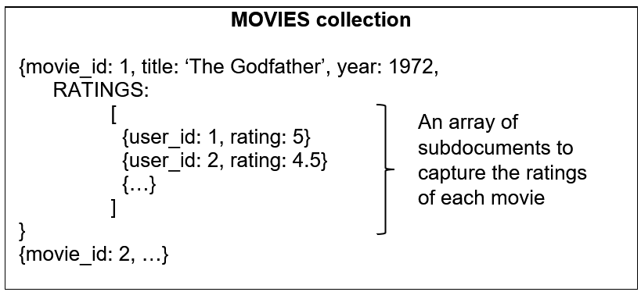
Document Databases
Instead of creating multiple collections (and creating relationships), one can also nest a document in another document
The nested document is called a subdocument
(This allows embedding one collection in another collection)

Slide 15
Task-technology Fit
"Alignment between a technology and the task this technology supports determines performance gains obtained from this technology "
Technology can be any information system (consisting of hardware, software, and data)
Task can be any action performed to generate outputs from a set of inputs
Performance can be efficiency, effectiveness, quality
Most commonly used metrics is "time savings"

Slide 16
Task-technology Fit
In this tutorial
Task: creating a utility matrix
Technology: a document database
Goal
Establish the best alignment between the query that generates the utility matrix and the document database's design

Slide 17
Dataset
Obtained from a relational database with the following design
1,682 movies
100,000 ratings
943 users

Slide 18
Problem
How should a hypothetical data scientist design the database (in MongoDB) so that they can create the utility matrix in the shortest amount of time?

Slide 19
Option 1
Create a collection for each entity
Establish relationships between collections using foreign keys

Slide 20
Option 2
Create a collection only for
Users
Movies
Ratings are "subdocuments" of movies
MOVIES collection
{movie_id: 1, title: ‘The Godfather’, release_year: 1972, …,
RATINGS:
[
{user_id: 1, rating: 5, rating_tstamp: 884646537}
{user_id: 2, rating: 4.5, rating_tstamp: 864246847}
{…}
]
}
{movie_id: 2, …}
{…}

Slide 21
Option 2
Create a collection only for
Users
Movies
Ratings are "subdocuments" of users
USERS collection
{user_id: 1, age: 21, gender: ‘F’, occupation: ‘student’, zipcode: 33620,
RATINGS:
[
{movie_id: 1, rating: 5, rating_tstamp: 884646537}
{movie_id: 2, rating: 3, rating_tstamp: 864246847}
{…}
]
}
{user_id: 2, …)
{…}

Slide 22
Demonstration
(Present the database designs by connecting to the MongoDB Atlas server)

Slide 23
In-class Discussion: Question 1
Which option should the data scientist select to create the utility matrix in the shortest amount of time; why?
Option 1
Option 2
Option 3

Slide 24
In-class Discussion: Question 2
If the data scientist wants to create "gender specific" recommendations, which option should they select to create the utility matrix in the shortest amount of time; why?
Option 1
Option 2
Option 3
(Note: gender-specific recommendations require creating a separate utility matrix for each gender in the database)

Slide 25
Demonstration
(Run the two Jupyter Notebooks that answer the two questions)

